Slide 1
COMPARE IT
AYUSH BEEKUM
SHAVIR VALLABH
JAITIN MOODALLY
CHINMAYI SANTHOSH
DIYA NAROTAM

Slide 2

GROUP ROLES
We divided the team into 2 parts, namely the backend team and frontend team. 2 people worked on creating our user friendly and interactive UI, and 3 people working on the functionality and API to make the website come to life and become fully functional, including integrating frontend with the backend
Frontend team: CHINMAYI SANTHOSH, DIYA NAROTAM
Backend team: AYUSH BEEKUM, SHAVIR VALLABH,
JAITIN MOODALLY

Slide 3
Problem
Customers
UX design
Customers are becoming to feel overwhelmed with the various options and fluctuating prices, it can feel to difficult to keep track.
The user experience for many of these websites feel clunky, or outdated, nothing compelling to keep a customer using their website.
Decline
Many of these websites are losing popularity because of not keeping up, poor user experience and lack of community interaction

Slide 4




Solution
Close the gap
Target audience
Cost savings
Easy to use
Our website offers a user friendly and interactive experience that is easy to use, keeps customers updated and keeps up with today’s demands
The best part is that anyone can use our service. We web scrape products from multiple sources to bring a wide range of options to view in the tech accessory department
We make sure our website finds the best offers for the any products you may be looking for, including sending you emails on products in your wish list if a new better offer is available
Our design ensures for an inviting and use- friendly experience that anybody can use with ease

Slide 5



Product Overview
Unique
Modern and updated
Only product specifically dedicated to the tech accessory market is considered
Technology is constantly evolving and becoming better consistently, our service ensures you are able to keep up
Tested
Authentic
Strenuous testing was done to ensure the website is 100% functional and working
Designed by young and bright minds eager to learn and adapt the to current 4IR

Slide 6
Our steps to making the website come alive

Slide 7



Task 1: researching OUR TOPIC
Research​
Abstract​
Design​
Driven by internet growth and COVID-19, online shopping has surged due to convenience, product variety, and competitive pricing.
Products categorized (electronics, apparel, etc.) and rated via star systems.
Personalization (recommendations, filters) and community reviews enhance engagement.
Success hinges on user-friendly UX, real-time price aggregation, and community-driven discovery to stand out in the competitive space.

Slide 8
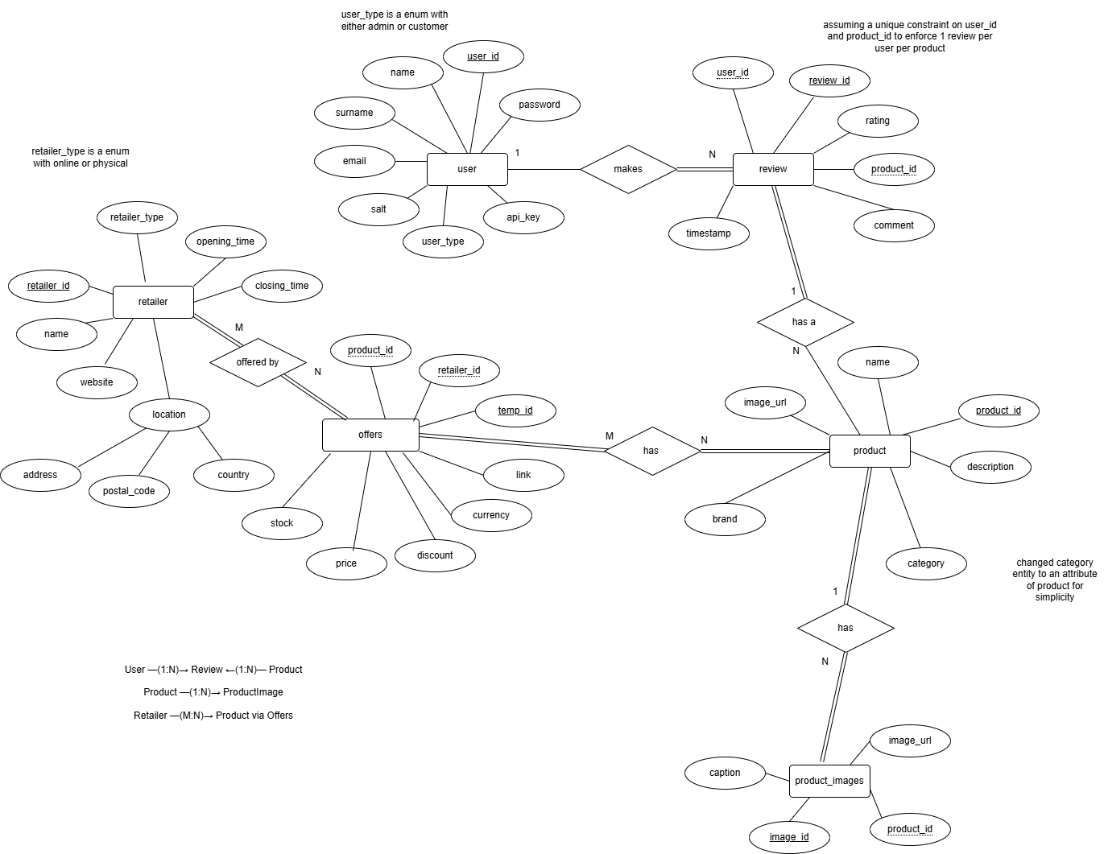
Task 2: ER Diagram overview

Slide 9
Task 3: Mapping the ER To a relational schema
Step one:
mapping of strong(regular) entity types and simple attributes
Step TWO:
Step FOUR:
Step SIX:
Add the Weak entities and connect relationship with their strong entity, in our ER we do not implement weak entities hence no entities will be in the schema
Connected the 1-N relationships
Mapping of multivalued attributes, we do not use multivalued attributes hence are not in the schema
Step THREE:
Step FIVE:
Step SEVEN:
No one-to-one relationships
Creating relationships from the M-N relationships
No N-ary relationships

Slide 10
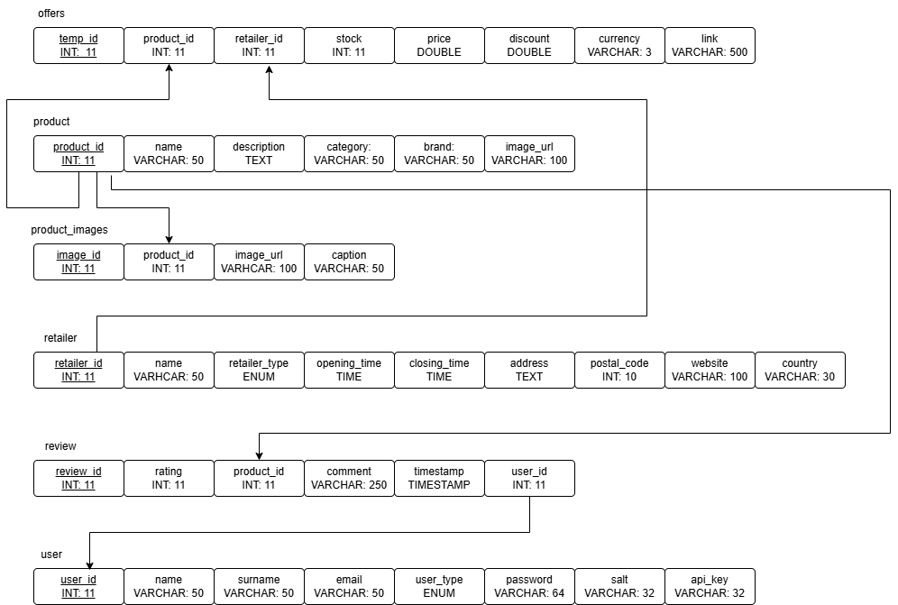
Task 4: RELATION SCHEMA

Slide 11
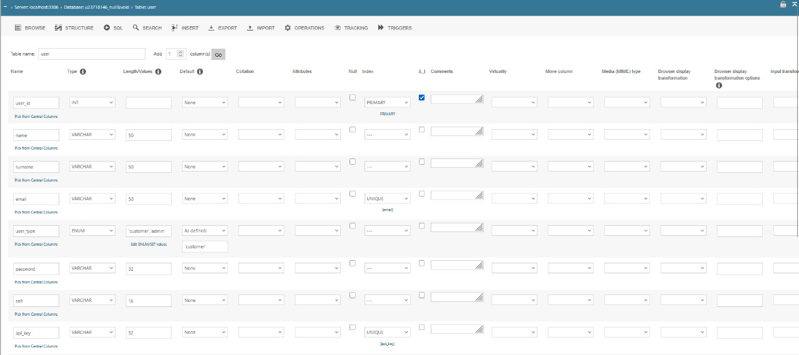
Our DATABASE STRUCTURE user table:

Slide 12
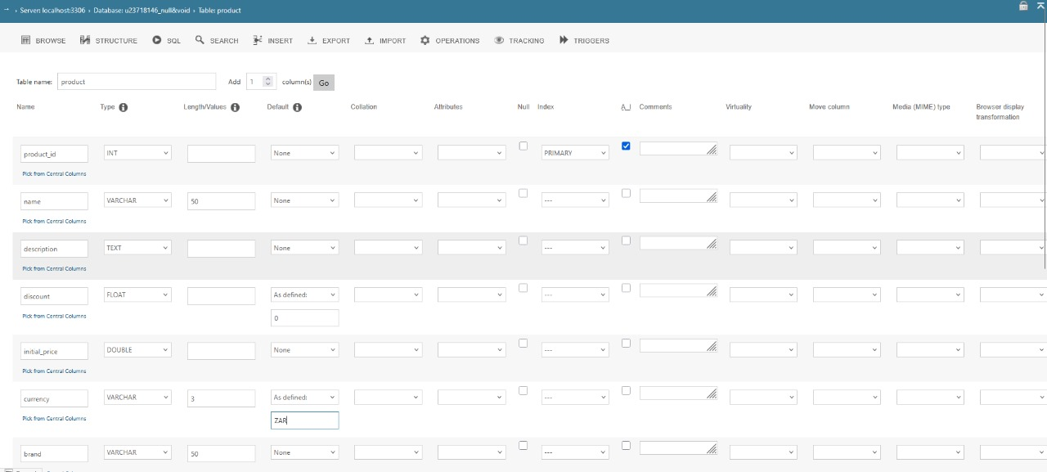
PRODUCT TABLE:

Slide 13
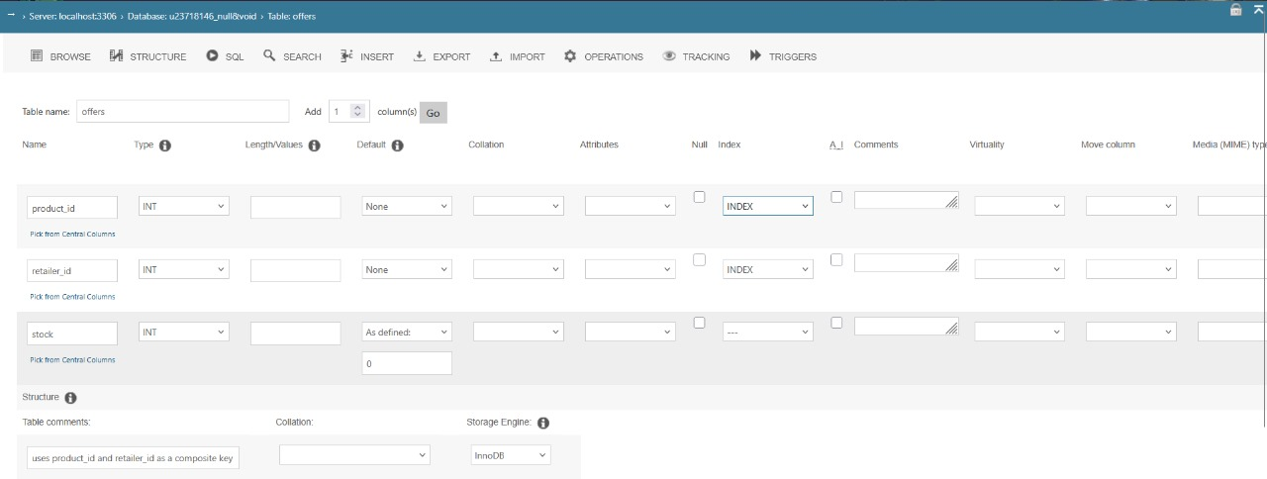
OFFERS TABLE:

Slide 14
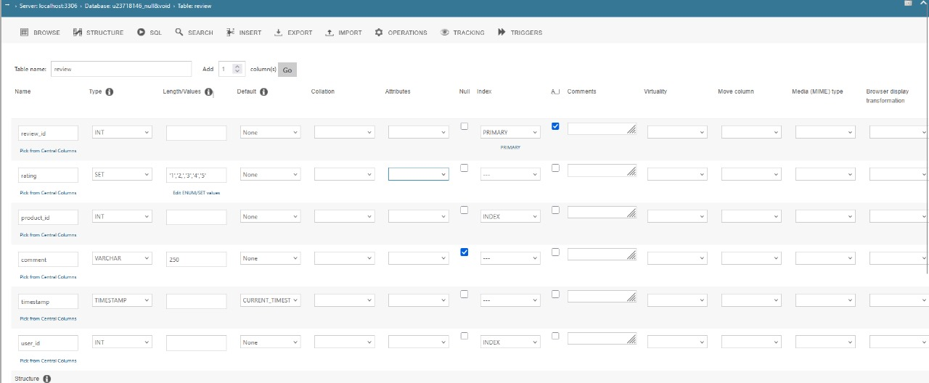
review TABLE:

Slide 15
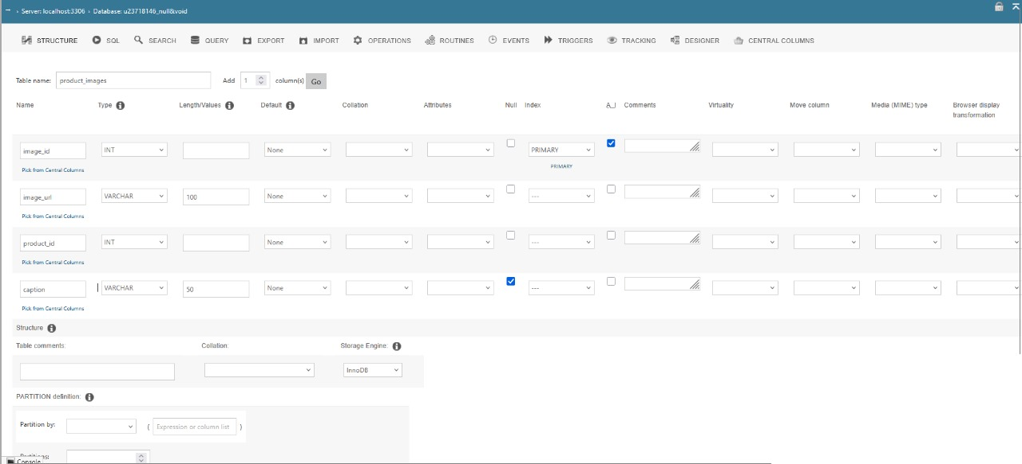
Product_image TABLE:

Slide 16
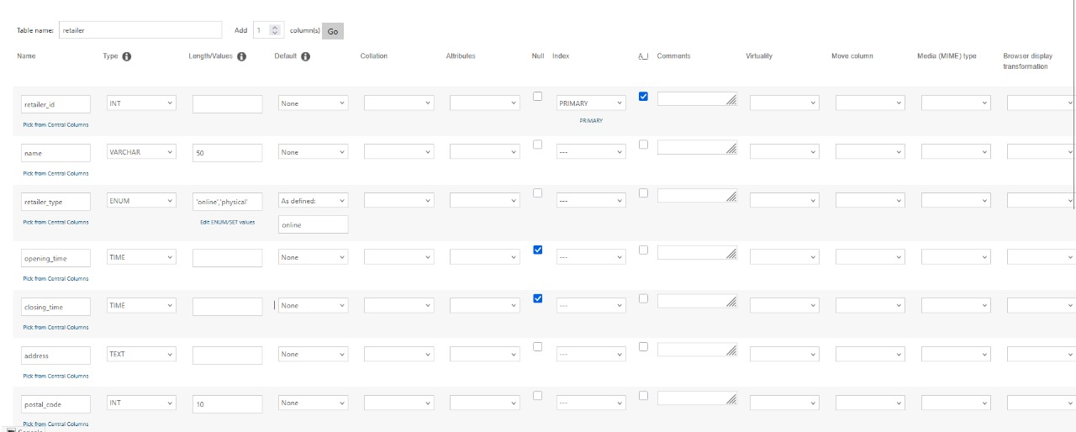
retailer TABLE:

Slide 17
Task 5:
Web-based Application
User management
Admin controls
Product display
User features
security
Login/signup for customers
Admin access via backend only
Separate dashboards (user/admin)
Exclusive: Add/edit/delete products & categories
Manage retailers, brands & product details
No SQL knowledge required
Prices, images & descriptions visible
Gallery view for product images
Multi-retailer price comparison
Sort/filter by category, price, name
Search functionality
Reviews/ratings (logged-in users only)
Prepared statements prevent SQL injection
Timestamped user reviews

Slide 18
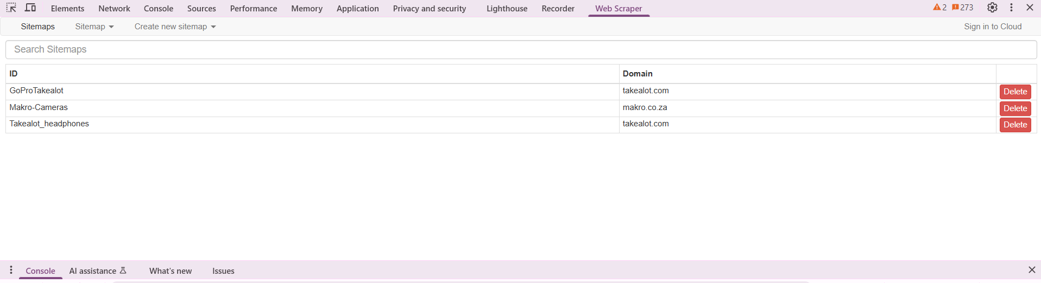
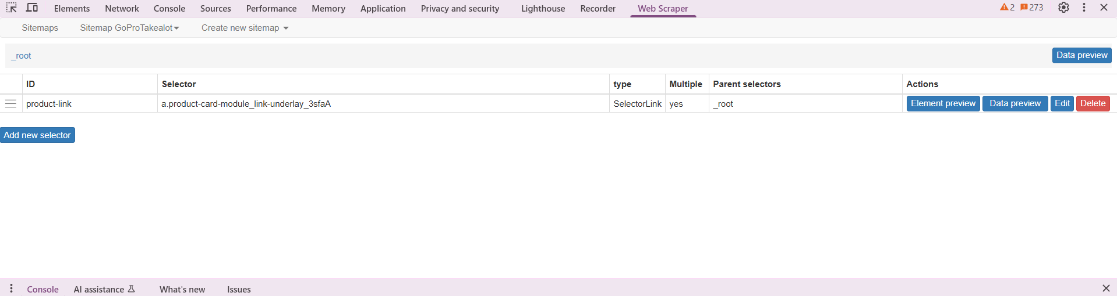
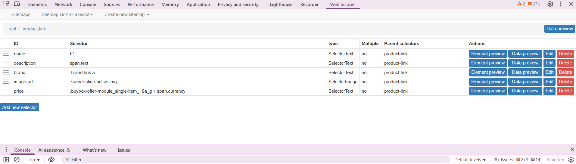
Task 6: data
Used Web Scraper.io (Chrome extension)
Created custom sitemaps per product category & retailer
Configured precise selectors for target data points
Automated extraction of product info for database
Executed automated scraping via configured sitemaps
Extracted targeted product datapoints
Organized raw data into structured Excel sheets
Prepared for database integration

Slide 19
Task 7: Analyze and optimize
1. Initial Performance (Before Index)
Query: SELECT * FROM product WHERE category = 'Audio'
Output:
type: ALL (Full table scan)
key: NULL (No index used)
rows: 300 (All rows scanned)
Execution Time: 2-5 ms (Inefficient for scaling)
2. Identified Bottleneck
Full table scan → O(n) complexity
No index on category column
3. Optimization Applied
Added Index:
sql
Copy
Download
ALTER TABLE product ADD INDEX (category);
4. Improved Performance (After Index)
Output:
type: ref (Indexed search)
key: category (Index used)
rows: ~30 (Only matching rows scanned)
Execution Time: 0.5-1 ms (2.5x faster)
5. Why Faster?
B-Tree Index enables O(log n) search complexity:
Directly jumps to 'Audio' entries
Reads only relevant rows (avoids full scans)

Slide 20
Task 8: development
Git Version Control
Branching Strategy:
front-end: UI development
back-end: Server/database logic
integration: Merged features for testing
Workflow:
Feature branches → Integration testing → Merge to main
Screenshot: Include image of commit history/branches
Code Quality
Data Validation:
Input sanitization (e.g., form fields, API requests)
Prepared statements for SQL queries
Structure & Readability:
Modular functions/files
Consistent naming conventions
Descriptive comments for complex logic

Slide 21
Task 10: bonus task – push the boundries
Accessibility improvements
Security Enhancements
Dark/Light Mode Toggle:
User preference-based UI
Color-blind friendly: Avoided red-green reliance
Inclusive Design:
Error states show icons + labels (not just color)
High contrast in both modes for readability
Environment Protection:
Used .env file for sensitive configs (no hardcoding)
Password Security:
SHA-256 hashing (no plaintext storage)
16-character salting (prevents rainbow table attacks)

Slide 22
Thank you from the compare it team
AYUSH BEEKUM
SHAVIR VALLABH
JAITIN MOODALLY
CHINMAYI SANTHOSH
DIYA NAROTAM

